Slide 1
CASE STUDY CREDIT EDA
Kakarla Roja Ramani

Slide 2
Table of Contents
Categorical Univariate Analysis for Target = 0
Categorical Univariate Analysis for Target = 1
Univariate analysis for variables Target = 0
Univariate analysis for variables Target =1
Bivariate analysis For Target = 0
Bivariate analysis For Target = 1
Correlation for Target = 0
Correlation for Target = 1
Bivariate Analysis

Slide 3
Categorical Univariate Analysis for Target =0

Slide 4
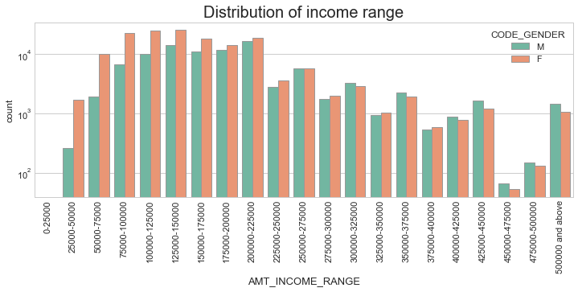
Distribution Of Income Range
Observations from the graph on the right side:
Income range from 75000-100000 to 200000-225000 is having more in number.
Very less count from income range 40000 and above.
Female counts are higher than Male.

Slide 5
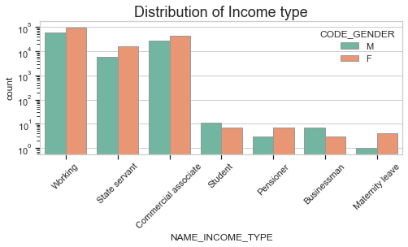
Distribution of Income Type
Observations from the graph on the right side:
Income type ‘Working’ ,Commercial Associate’, and ‘State Servant’ the number are higher than others.
Income type ‘student’ ,’pensioner’, ‘Businessman’ and ‘Maternity leave’ are less in number.
Female counts are higher than male

Slide 6
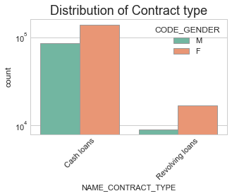
Distribution of Contract type
Observations from the graph on the right side:
Contract type ‘cash loans’ is having higher number than ‘Revolving loans’ contract type.
Female counts are higher than male.

Slide 7
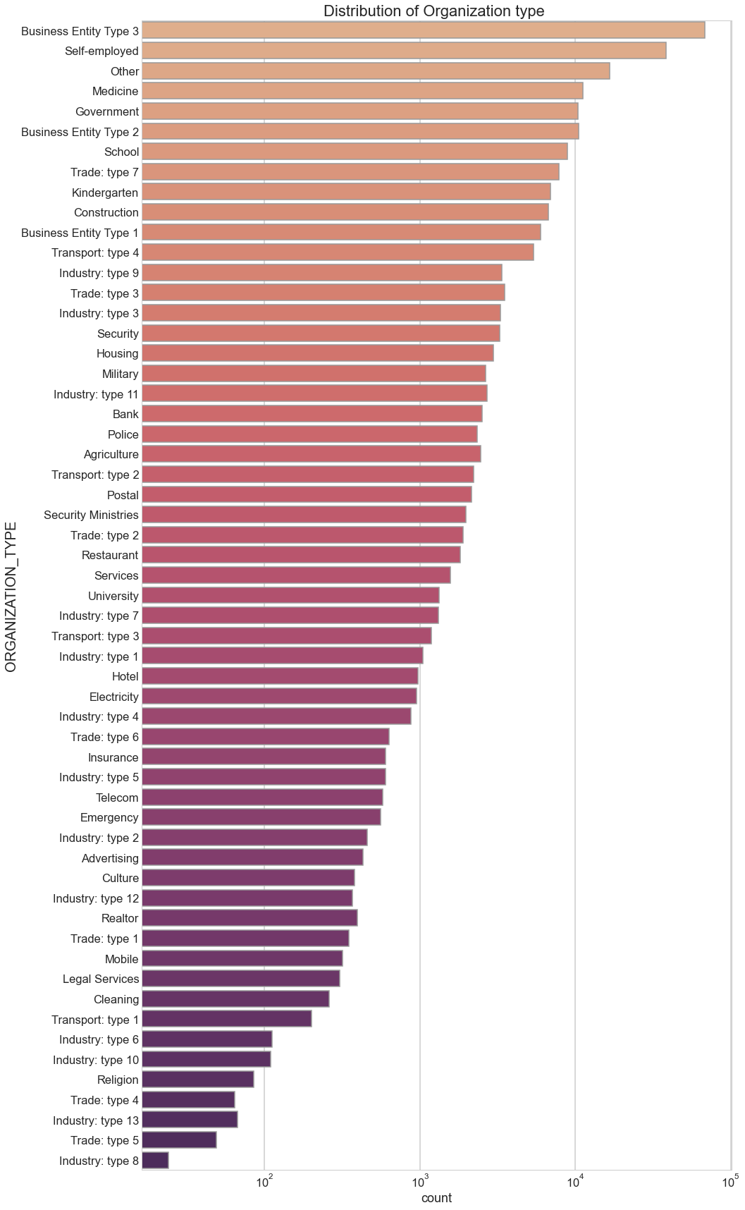
DISTRIBUTION OF ORGANIZATION TYPE
Observations from the graph on the right side:
Most clients are from the organization type ‘Business entity Type 3’ , ‘Self employed’, ‘Other’ , ‘Medicine’ and ‘Government’.
Less clients are from Industry type 8, Trade type 5, Industry type 13, Trade type 4, Religion and Industry type 10 .

Slide 8
Categorical Univariate Analysis for Target = 1

Slide 9
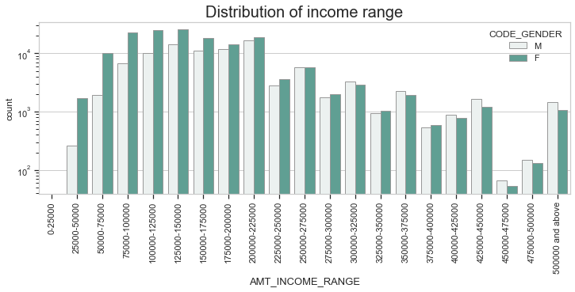
DISTRIBUTION OF INCOME RANGE
Observations from the graph on the right side:
Male counts are higher than female in higher income range whereas below 250000 female are higher than male.
Income range from 75000-100000 to 175000-200000 are more number.
Very less count for income range 400000 and above.

Slide 10
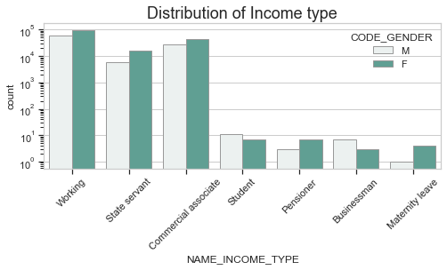
DISTRIBUTION OF INCOME TYPE
Observations from the graph on the right side:
Income type ‘working’, ’commercial associate’, and ‘State Servant’ are higher than others.
For this Females are having more number than male.
Income type ‘student’ ,’pensioner’, ‘Businessman’ and ‘Maternity leave’ are less in number.

Slide 11
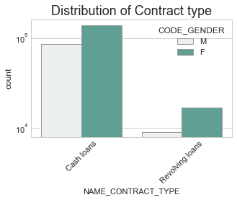
DISTRIBUTION OF CONTRACT TYPE
Observations from the graph on the right side:
Contract type ‘cash loans’ is having higher number than ‘Revolving loans’ contract type.
Female counts are higher than male.

Slide 12
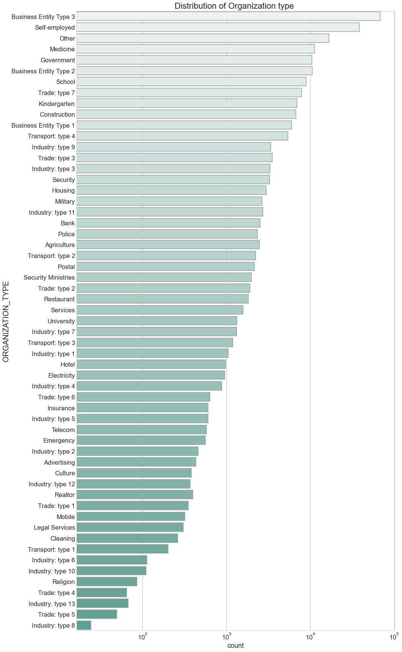
DISTRIBUTION OF ORGANIZATION TYPE
Observations from the graph on the right side:
Most clients are from the organization type ‘Business entity Type 3’ , ‘Self employed’, ‘Other’ , ‘Medicine’ and ‘Government’.
Less clients are from Industry type 8, Trade type 5, Industry type 13, Trade type 4, Religion and Industry type 10.

Slide 13
Univariate analysis for variables Target=0

Slide 14
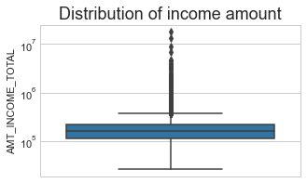
BOX PLOT FOR INCOME AMOUNT
Some outliers are noticed in income amount.
The third quartiles is very slim for income amount.
The first quartile is bigger than third quartile which means most clients are from first quartile.

Slide 15
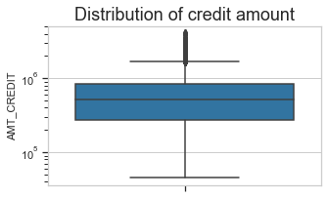
BOXPLOT FOR CREDIT AMOUNT
Some outliers are noticed in credit amount.
The first quartile is bigger than third quartile for credit amount.
Most of the credits of clients are present in the first quartile.

Slide 16
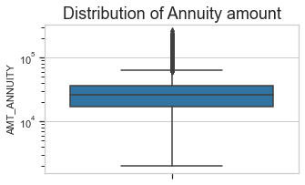
BOXPLOT FOR ANNUITY AMOUNT
Some outliers are noticed in annuity amount.
The first quartile is bigger than third quartile for annuity amount which means most of the annuity clients are from first quartile.

Slide 17
Univariate analysis for variables Target=1

Slide 18
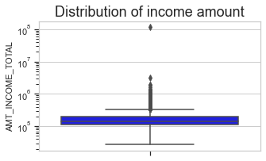
BOXPLOT FOR INCOME AMOUNT
Some outliers are noticed in income amount.
The third quartiles is very slim for income amount.
Most of the clients of income are present in first quartile.

Slide 19
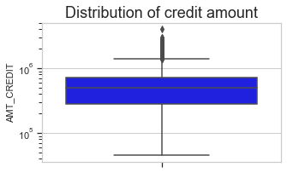
BOXPLOT FOR CREDIT AMOUNT
Some outliers are noticed in credit amount.
The first quartile is bigger than third quartile for credit amount which means most of the credits of clients are present in the first quartile.

Slide 20
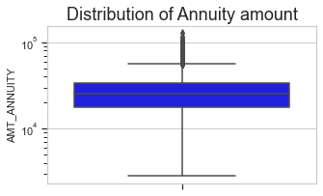
BOXPLOT FOR ANNUITY AMOUNT
Some outliers are noticed in annuity amount.
The first quartile is bigger than third quartile for annuity amount which means most of the annuity clients are from first quartile.

Slide 21
Bivariate analysis For Target = 0

Slide 22
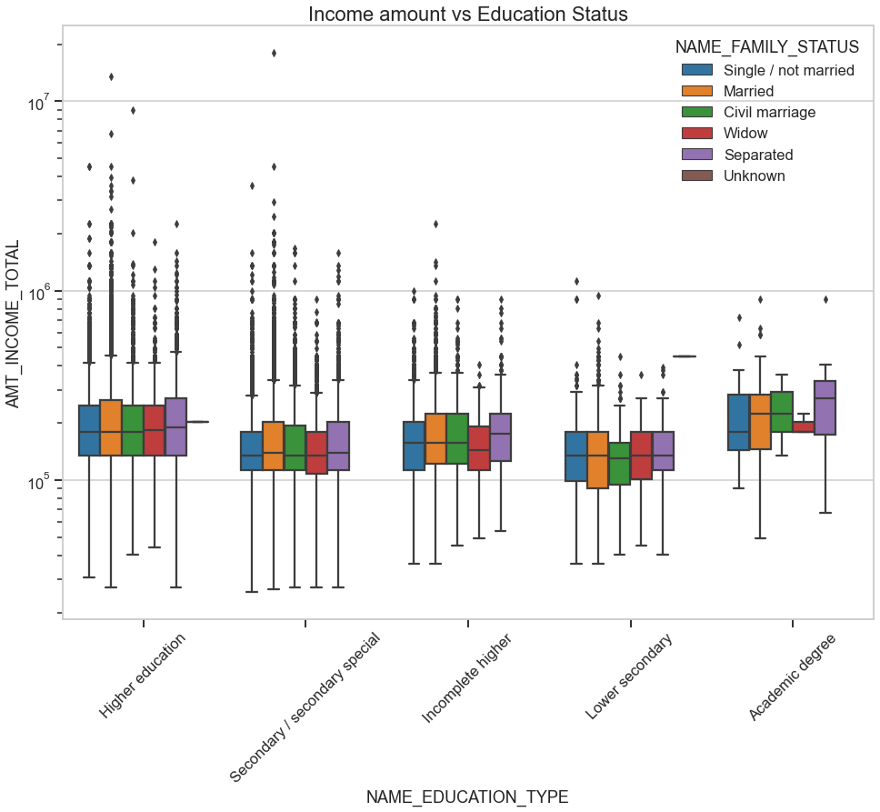
Income amount vs Education Status
Education type 'Higher education' the income amount is mostly equal with family status.It contains many outliers
Less outlier are having for Academic degree but there income amount is little higher than that of Higher education.
Lower secondary are have less income amount than others especially of civil marriage family status.

Slide 23
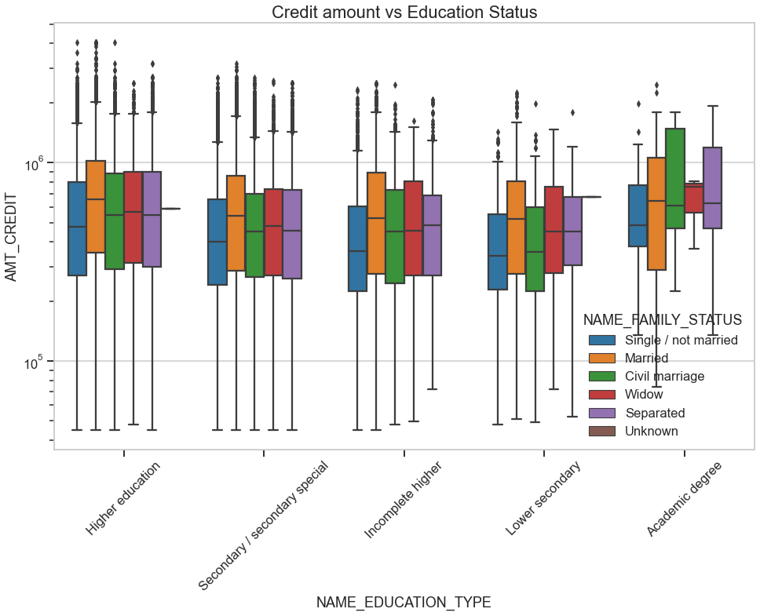
Credit amount vs Education Status
Family status of 'civil marriage', 'marriage' and 'separated' of Academic degree education are having higher number of credits than others.
Higher education are having more outliers.
'Civil marriage' and 'separated' for Academic degree is having most of the credits in the third quartile.

Slide 24
Bivariate analysis For Target = 1

Slide 25
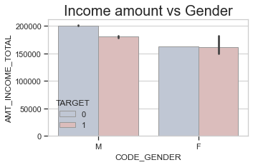
Income amount vs Gender
Females defaulters as well as payee are equal.
Males has the higher percentage of payee than defaulter.

Slide 26
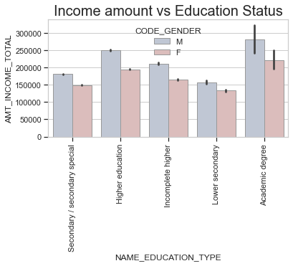
Income amount vs Education Status
Males irrespective of the education status and total income they earn which is slightly higher than females default more than females.

Slide 27
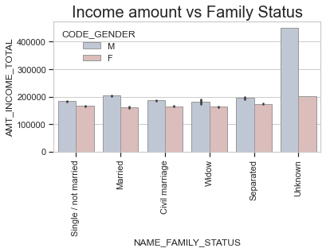
Income amount vs Family Status
Males irrespective of the family status and total income they earn (which is slightly higher than females) default more than females.

Slide 28
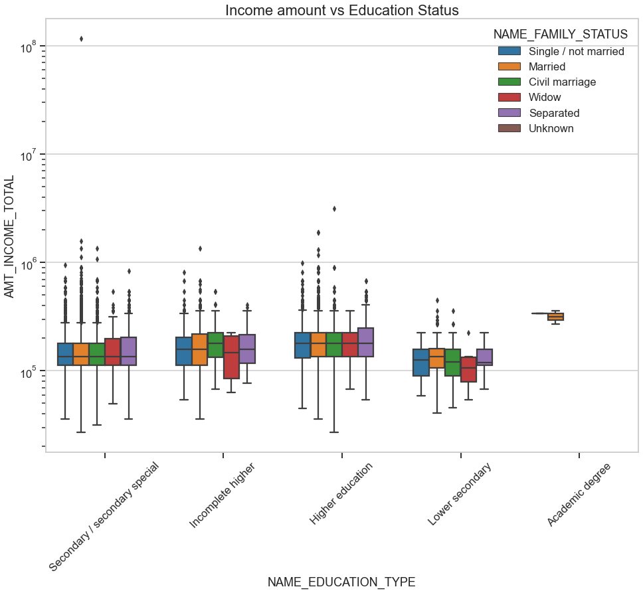
Income amount vs Education Status
For Education type 'Higher education' and 'Secondary' the income amount is mostly equal with family status.
Less outlier are having for Academic degree, there income amount is little higher that Higher education. There is no data other than single and married
Lower secondary are have less income amount than others.

Slide 29
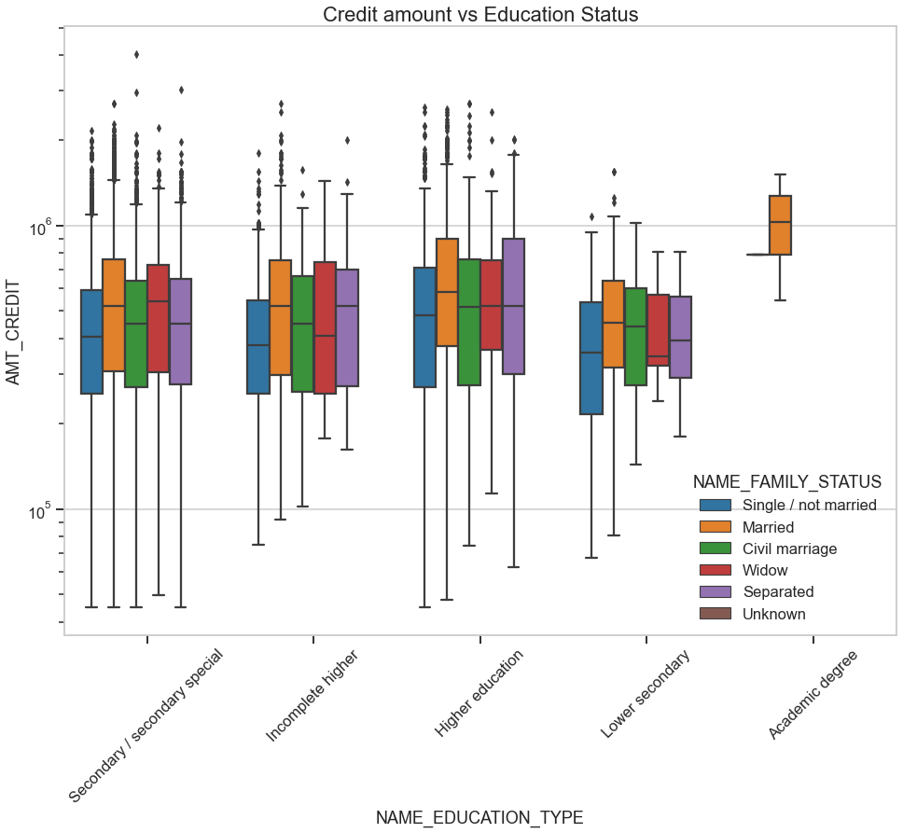
Credit amount vs Education Status
Most of the outliers are from Education type 'Higher education' and 'Secondary'.
'Married' for Academic degree is having higher credit than others. There is no data other than single and married.

Slide 30
Correlation for target = 0

Slide 31
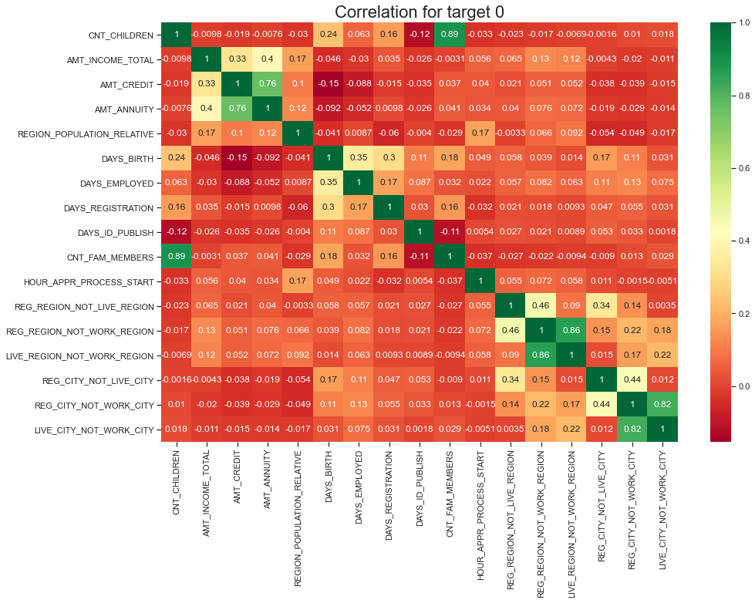

Slide 32
Correlation for target = 0
Credit amount is inversely proportional to the date of birth, which means Credit amount is higher for low age and vice-versa.
Credit amount is inversely proportional to the number of children client have, means Credit amount is higher for less children count client have and vice-versa.
Income amount is inversely proportional to the number of children client have, means more income for less children client have and vice-versa.
less children client have in densely populated area.
Credit amount is higher to densely populated area.
The income is also higher in densely populated area.

Slide 33
Correlation for target = 1

Slide 34
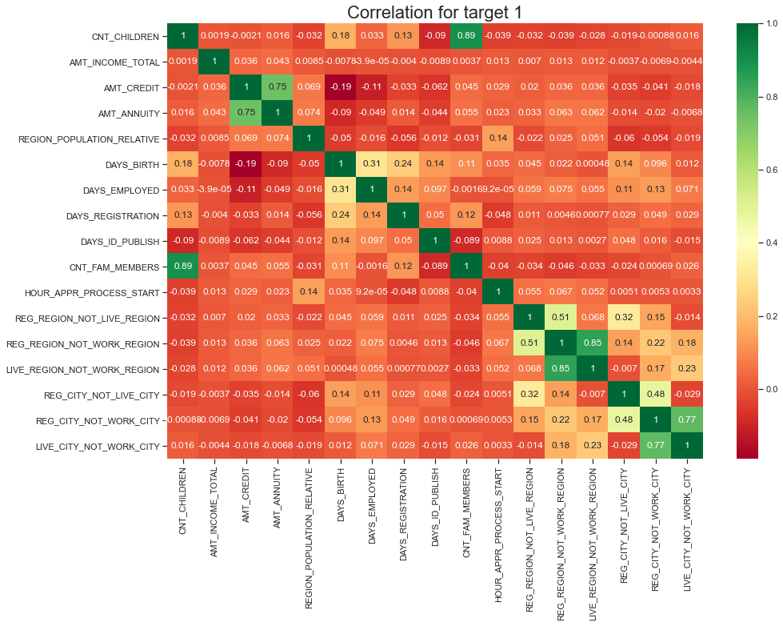

Slide 35
Correlation for target = 1
This heat map for Target 1 is also having quite a same observation just like Target 0. But for few points are different. They are listed below.
The client's permanent address does not match contact address are having less children and vice-versa the client's permanent address does not match work address are having less children and vice-versa.

Slide 36
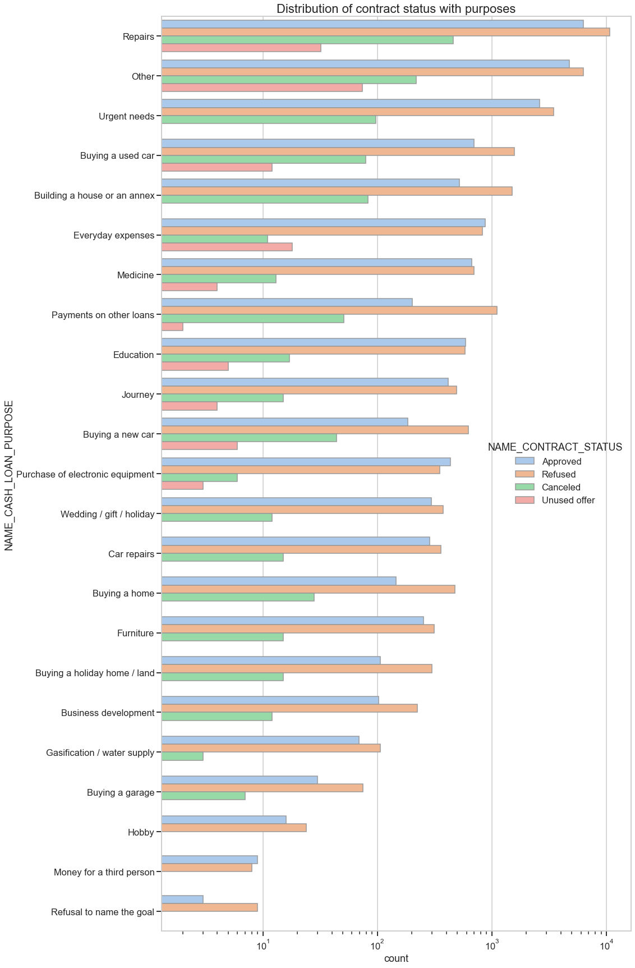
Distribution of contract status with purposes
Most rejection of loans came from purpose 'repairs'.
For education purposes we have equal number of approves and rejection.
Paying other loans and buying a new car is having significant higher rejection than approves.

Slide 37
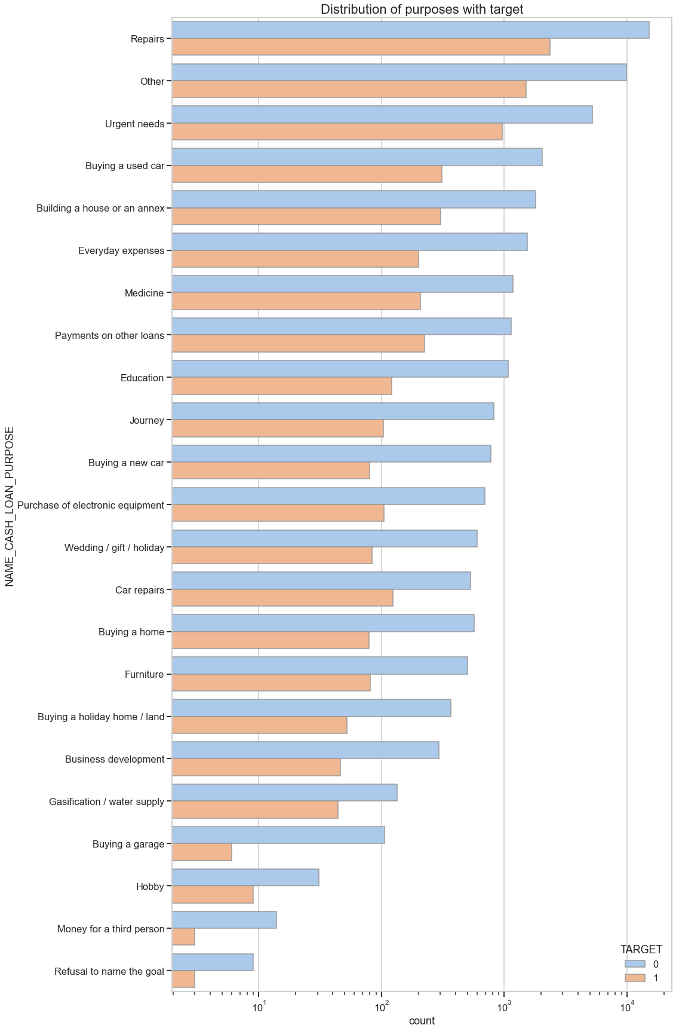
Distribution of purposes with target
Loan purposes with 'Repairs' are facing more difficulites in payment on time.
There are few places where loan payment is significant higher than facing difficulties. They are 'Buying a garage', 'Business developemt', 'Buying land','Buying a new car' and 'Education'.

Slide 38
Bivariate analysis

Slide 39
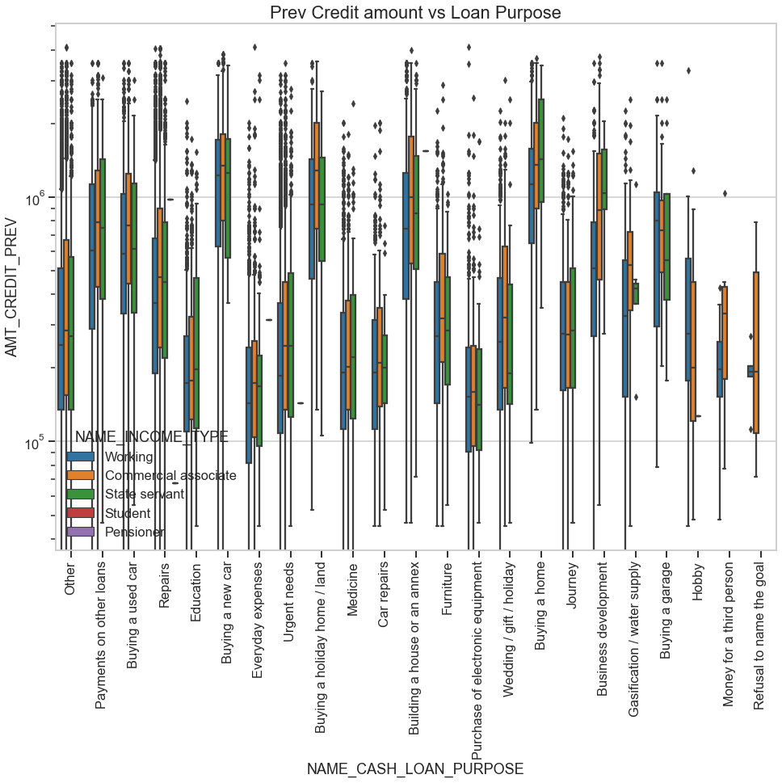

Slide 40
Previous Credit amount vs Loan Purpose
The credit amount of Loan purposes like 'Buying a home','Buying a land','Buying a new car' and'Building a house' is higher.
The credit amount of Loan purposes like 'Everyday eexpenses'and'Purchase of electronic equipment' is lower.
Money for 'third person' or a 'Hobby' is having less credits applied for.

Slide 41
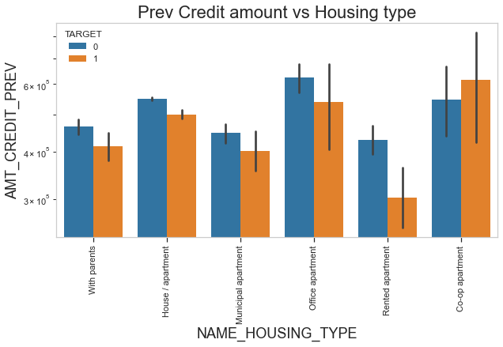
Previous Credit amount vs Housing type
For housing type, office appartment is having higher credit of target 0 and co-op apartment is having higher credit of target 1.
So, we can conclude that bank should avoid giving loans to the housing type of co-op apartment as they are having difficulties in payment.
Bank can focus mostly on housing type with parents or House\appartment or muncipal appartment for successful payments.

Slide 42
CONCLUSION
Banks should focus more on contract type ‘Student’ ,‘pensioner’ and ‘Businessman’ for successful payments.
Get as much as clients from housing type ‘With parents 'or House\apartment or municipal apartment as they are having least number of unsuccessful payments.

Slide 43
THANK YOU

